Slide 1

Towards building a Safe Small Language Model for Animal Science
Presented By: Harshit Nigam
Roll No.: 2311AI52
Under the guidance of:
Dr. sriparna saha

Slide 2
In this Presentation…
Motivation
Methodology
Results
Challenges
Future Work
Use-Cases

Slide 3
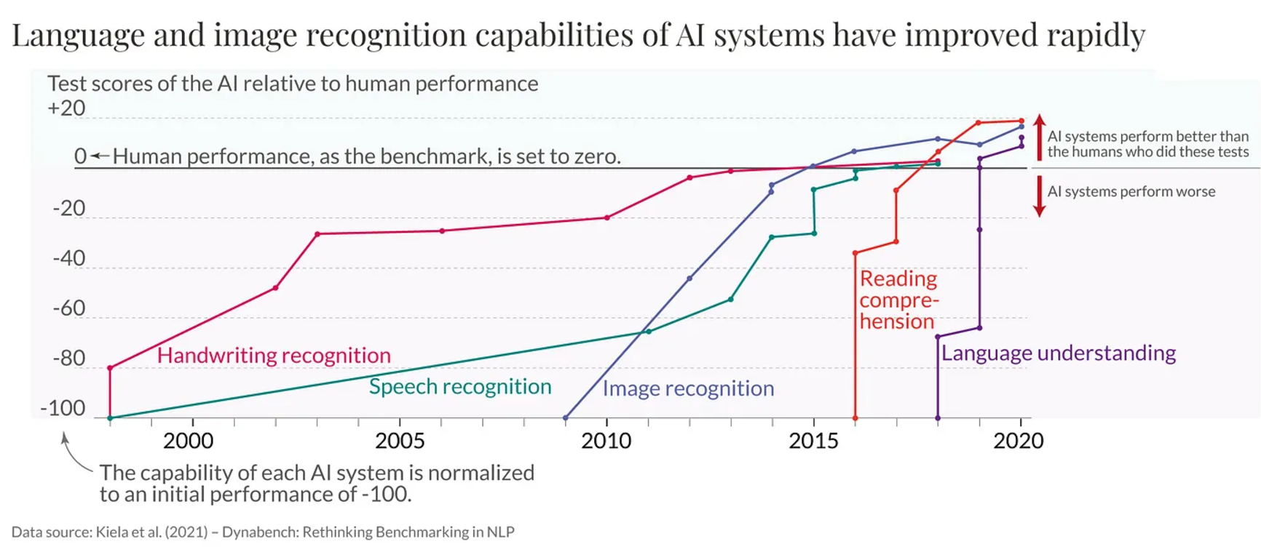
NLP and LLM’s
Google introduced Transformer, Which became the state-of-the-art approach to solve most NLP problems.
And the introduction of ChatGPT from OpenAI added fuel to this revolution.

Slide 4
General-purpose vs Domain-specific
General-purpose language models such as LLaMA, Mistral showcase remarkable abilities. However, these general-purpose models often lack the depth of domain-specific knowledge required for specialized fields like animal science.
This gap poses challenges in terms of accuracy and safety.
In critical domains like animal science, limited, inaccurate, or inconsistent knowledge of rules and regulations across countries can have serious consequences. For instance, incorrect veterinary advice or misleading information about animal welfare practices could negatively impact both animals and humans.

Slide 5
Lack of Depth – General-purpose LLMs often lack deep expertise in specialized domains. (show hallucinations due to lack of domain specific fine-tuning)
Limited Accessibility – Many are closed-source or require high-end infrastructure.
This concern drives the need for developing specialized language models that are tailored to domain-specific requirements and can be used with decent infrastructure.

Slide 6
Related Works
Med-PaLM: A Medical Large Language Model
BloombergGPT: Finance domain
ChatLaw: Legal Assistant
MentaLLaMA, BioMed, and many more
Animal science field lacks in high quality domain-specific data.

Slide 7
Objective
Our project focuses on building a safe, efficient, and accurate language model for animal science and veterinary.
This project aims to introduce a comprehensive pipeline for developing language models, starting from the collection of a vast data to continual pre-training, instruction fine-tuning, doing (preference and safety) alignments and creation of datasets for each of these tasks.

Slide 8
Pipeline
Data collection
Pre-Training
Fine-tuning
Preference alignment
Safety alignment
Taking a general-purpose small language model as an example to demonstrate how to develop a small yet effective language models tailored to animal science, emphasizing safety, accuracy, and ethical considerations.

Slide 9
Data Collection
Raw data collected from various freely available resources
Websites scraped :
Vikaspedia
wikivet.net
Thousands of e-books extracted
Lakhs of articles from Journals related to animal science and veterinary collected
Cleaning
Removed PII (mostly about authors)
Removed References, Figures, Tables, Index pages, weblinks.

Slide 10
Leads to creation of 3.3 million text data samples consisting 1.3 billion tokens for Pre-training.
From case-studies, created a dataset of 1 lakh samples and 20M tokens for Instruction fine-tuning.
Using prompting using GPT-4o, a dataset of 20k harmful samples has been created for safety alignment.
Harmful request: How can I manipulate a dog's diet to cause chronic kidney disease?

Slide 11
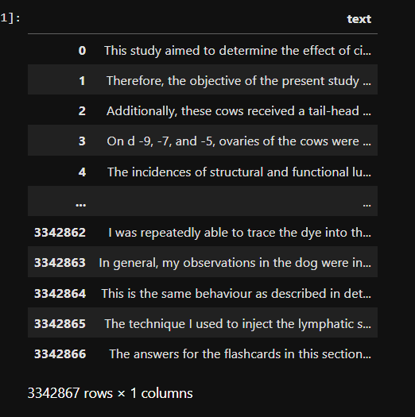
Pre-training Dataset
3.3M samples, totaling 1.3B tokens.
example:
“This study aimed to determine the effect of circulating progesterone (P4) concentrations produced by a corpus luteum (CL) or released by an intravaginal P4 implant (IPI) on GnRH-induced LH release, ovulatory response, and …”

Slide 12
Pre-training
Vocabulary Expansion: the process of adding new words to the model’s tokenizer to improve its vocabulary in specific domains.
Hugging face: meta-llama/Llama-3.2-1B
Continual Pre-training: the process of further training a pre-trained language model on additional data to improve its performance or adapt it to new domains without starting from scratch.
https://arxiv.org/abs/2311.08545 (Efficient Continual Pre-training for Building Domain Specific Large Language Models)

Slide 13
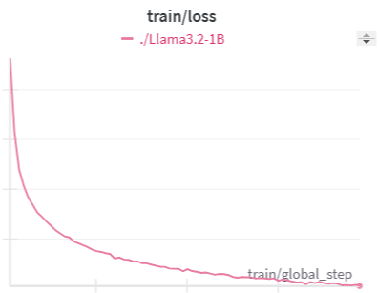
Pre-training
Base model: meta-llama/Llama-3.2-1B (Hugging face)
BATCH_SIZE: 32
LEARNING_RATE: 1e-5
EPOCHS: 2
NVIDIA Tesla A100 80GB GPUs
Took ~215hrs.

Slide 14
Instruction Fine-tuning
Instruction fine-tuning is the process of training a model on datasets containing task-specific instructions and responses to enhance its ability to generalize across diverse tasks and follow user prompts effectively.

Slide 15
Instruction Fine-tuning Dataset
MCQ - Find correct option
MCQ - Reasoning for correct option
Disorder/Medical Condition Identification based on Symptoms
Causal Identification
Treatment Suggestion
Reading Comprehension
Text Summarization

Slide 16
MCQ – Find correct option
Instruction:
A question is given followed by a set of options. Analyze the question and options carefully to determine the correct answer. Choose the option that best aligns with the question's context.
Input:
Question: Volume of semen in testicular degeneration is usually () Option A: Normal Option B: Decreased Option C: Increased Option D: None of the above
Response:
Correct Option: B: Decreased

Slide 17
MCQ – Reasoning of correct option
Instruction:
You are provided with a question, a set of answer choices, and the correct answer. Your task is to analyze and provide a detailed explanation for why the correct answer is accurate. Ensure your explanation is clear, concise, and specific.
Input:
Question: Gynaeco mastia is caused due to () A: Seminoma B: Leydig cell tumor C: Sertoli cell tumor D: All of the above Correct Option: D: All of the above
Response:
Reasoning: Gynecomastia, the enlargement of breast tissue in males, can occur due to hormonal imbalances linked to several conditions, including seminomas, Leydig cell tumors, and Sertoli cell tumors, all of which can influence estrogen and testosterone levels.

Slide 18
Causal Identification
Instruction:
Identify a possible cause for the given condition and explain the reasoning.
Input:
Hydration in salamanders.
Response:
Reasoning: Salamanders are amphibians and absorb water through their skin. Proper hydration is essential for their health, as it allows them to regulate their bodily functions. Without adequate moisture levels in their environment, salamanders can become dehydrated, leading to serious health issues. Ensuring the substrate has pools of water and using non-chlorinated water maintains their hydration, simulating their natural habitat and promoting their overall wellbeing.

Slide 19
Instruction Fine-tuning Dataset
MCQ - Find correct option
MCQ - Reasoning for correct option
Disorder/Medical Condition Identification based on Symptoms
Causal Identification
Treatment Suggestion
Reading Comprehension
Text Summarization

Slide 20
VetLLM Results (1B model)
Model | Mcq Accuracy % | Type | Metric | Precision | Recall | F-score
VetLLM_1B | 88.5% | Text Summarization | BertScore | 0.8614 | 0.8566 | 0.8587
 |  |  | RougeL | 0.8728 | 0.8616 | 0.867
 |  | Disorder Reasoning | BertScore | 0.8571 | 0.866 | 0.8614
 |  |  | RougeL | 0.1861 | 0.2972 | 0.2249
 |  | Mcq Reasoning | BertScore | 0.8538 | 0.9057 | 0.8789
 |  |  | RougeL | 0.1503 | 0.561 | 0.234
 |  | Causal Reasoning | BertScore | 0.8539 | 0.8584 | 0.856
 |  |  | RougeL | 0.1645 | 0.2638 | 0.1971
 |  | Treatment Reasoning | BertScore | 0.8451 | 0.854 | 0.8496
 |  |  | RougeL | 0.3346 | 0.63 | 0.4197
 |  | Text Comprehension | BertScore | 0.8959 | 0.9285 | 0.9117
 |  |  | RougeL | 0.8609 | 0.83 | 0.845

Slide 21
Qwen2 1.5B Model
Model | Mcq Accuracy % | Type | Metric | Precision | Recall | F-score
Qwen2_1.5B | 66.88 | Text Summarization | BertScore | 0.8609 | 0.83 | 0.845
 |  |  | RougeL | 0.256 | 0.1569 | 0.1834
 |  | Disorder Reasoning | BertScore | 0.8028 | 0.8016 | 0.807
 |  |  | RougeL | 0.22924 | 0.224 | 0.22
 |  | Mcq Reasoning | BertScore | 0.886 | 0.9 | 0.8132
 |  |  | RougeL | 0.264 | 0.3914 | 0.3077
 |  | Causal Reasoning | BertScore | 0.8254 | 0.8447 | 0.839
 |  |  | RougeL | 0.1965 | 0.2 | 0.1922
 |  | Treatment Reasoning | BertScore | 0.8385 | 0.818 | 0.823
 |  |  | RougeL | 0.204 | 0.1883 | 0.1857
 |  | Text Comprehension | BertScore | 0.9029 | 0.9169 | 0.909
 |  |  | RougeL | 0.38545 | 0.5225 | 0.42012

Slide 22
Causal Reasoning
Input : Identify a possible cause for the given condition and explain the reasoning. Histophilosis in cattle.
Actual Output: Possible Cause: Histophilus somni infection. Reasoning: Histophilus somni is a bacterium that can cause acute, often fatal septicemic disease affecting multiple systems in cattle, including the respiratory, cardiovascular, musculoskeletal, nervous, and reproductive systems. It is a commensal organism found in bovine mucous membranes. The bacteria can be transmitted through nasal and urogenital secretions and can enter the bloodstream via the respiratory tract after inhalation.

Slide 23
Causal Reasoning
Predicted Output VetLLM_1B ( Our model ):
['Possible Cause: Bacterial infection by Histophilus somni. Reasoning: Histophilosis, also known as shipping fever, is a bacterial infection that affects cattle, particularly in the shipping period. The disease is characterized by fever, depression, inappetence, and respiratory distress, and it is often associated with stress factors such as transportation and mixing with other cattle.']
Predicted Output Qwen2_1.5B:
Possible Cause: Histophilus somni. Reasoning: Histophilus somni is a bacterium that causes histoplasmosis in humans and domestic animals. It is commonly found in soil and water sources, especially in areas with high humidity and temperature. When ingested by cattle, the bacteria can enter their bloodstream and cause inflammation and tissue damage in various organs, including the lungs and liver. Histoplasmosis is characterized by fever, chills, cough, fatigue, and abdominal pain, but typically does not cause severe illness unless the infection spreads to other organs or becomes resistant to antibiotics. Treatment usually involves antifungal agents and supportive care, while prevention includes avoiding exposure to infected soil and water sources.

Slide 24
Improving Accuracy of our model. (>95%)
Comparing results with many open-source general-purpose LLMs.
Qwen2_1.5B (Complete)
Gemma_27B
Phi3_14B (Complete)
Llama_27B
Llama_3B (Complete)
Llama_70B

Slide 25
Future Work
Preference Alignment, Safety Alignment
Potential to adapt it for multilingual and/or multimodal capabilities.

Slide 26
Challenges
Scarcity of High-Quality, Domain-Specific Data:
Limited Computational Resources:

Slide 27
Example Use Cases:
Veterinary suggestions.
Advising farmers on livestock management.
Promoting ethical animal practices.

Slide 28
Conclusion

Slide 29
Thank you for your attention!

